Slide 1








Mergers and Acquisitions Toolkit Overview and Approach
I. Define your M&A Strategy
II. Identify Target Companies
III. Build a Business Case and an M&A Financial Model
IV. Conduct Due Diligence
V. Execute Transaction
VI. Conduct the Post Merger Integration
Frameworks
Best Practices
Templates

Slide 2



Introduction
This Toolkit was created by former JP Morgan Investment Bankers, and McKinsey & Deloitte Consultants, after more than 4,000 hours of work. It is considered the world's best & most comprehensive Mergers and Acquisitions Toolkit. It includes all the Frameworks, Tools & Templates required to improve the M&A capability of your organization and boost your personal career.
Join the 200,000+ Executives, Consultants & Entrepreneurs who are already leveraging our Management Consulting Toolkits to improve the performance of their organization and boost their own career.
If you have any questions, send us an email at support@domontconsulting.com and one of our ex-McKinsey, Deloitte & BCG Management Consultants will get back to you within 2 business days.”
Aurelien Domont
Management Consultant
Domont Consulting Managing Director

Slide 3

There are 3 main corporate growth strategies
1
2
3
Organic Growth Strategy
Mergers and Acquisitions Strategy
Strategic Alliances Strategy

Slide 4
Organic Growth Strategy
Description
Advantages
Disadvantages
Organic Growth Strategy
Often perceived as the default growth option for companies, an organic growth strategy relies on developing a company’s internal resources and capabilities
Provides deeper first-hand knowledge that is likely to be internalized in the company
Helps spread investment over time and reduce upfront commitment
There are no availability constraints, that is to say that the company is not dependent on the availability of suitable acquisition targets or potential alliance partners
Strategic independence
Creation of new activities within the existing culture environment
Can be slow, expensive, and risky
Difficult to use existing capabilities as the platform for major leaps in terms of innovation, diversification, or internationalization

Slide 5
Mergers and Acquisitions Strategy
Description
Advantages
Disadvantages
Mergers and Acquisitions Strategy
Mergers and acquisitions (M&A) bring together companies through complete changes in ownership. They have been used by companies for centuries and remain a major way for companies to expand rapidly
Business extension: M&A can be used to extend the reach of a firm in terms of geography, products, or markets
Building capabilities: M&A may increase a company’s capabilities
Increase market power by reducing competition and increasing bargaining power with suppliers
Increase efficiency: by sharing resources and capabilities
Speed: M&A allows acquirers to act fast
Financial efficiency: by combining the 2 balance sheets
Tax efficiency
Important investment upfront
Potential culture clash between the 2 companies
High failure rate
Sometimes excessive initial valuations, exaggerated expectations of strategic fit, and underestimated problems of organizational fit

Slide 6
Strategic Alliances Strategy
Description
Advantages
Disadvantages
Strategic Alliances Strategy
Two companies share resources and activities to pursue a common strategy.
In terms of ownership, there are two main kinds of strategic alliance: equity and nonequity alliances. Equity alliances involve the creation of a new entity that is owned separately by the partners involved (e.g., joint venture). Nonequity alliances do not involve the commitment implied by ownership and are often based on contracts (franchising, licensing)
Requires less commitment than other forms of expansion
Scale alliances can provide economies of scale
Access alliances involve a company allying in order to access the capabilities of another company that are required to produce or sell its own products and services
Complementary alliances involve companies combining their complementary capabilities
High failure rate (~50%)
Sometimes suffer from miscalculations in terms of strategic and organizational fit
The lack of control on either side can lead to particular issues of trust and coevolution

Slide 7
This Toolkit will focus on Mergers and Acquisitions
1
2
3
Organic Growth Strategy
Mergers and Acquisitions Strategy
Strategic Alliances Strategy

Slide 8
Main problem of the M&A strategy More than half of M&As fail to reach their value creation objectives.
*Consolidation of multiple surveys from New York Times, Harvard Business Review, and Australia Financial Review

Slide 9






Our solution To increase your M&A success rate, our ex-Deloitte & McKinsey management consultants and JP Morgan investment bankers have created a Mergers & Acquisitions Toolkit including 8 components.
Best Practices
Frameworks
What’s inside our Toolkit?
Advice from
tier-1 Management Consultants
Tools
Real-life Examples
Templates
Video Training
Step-by-step Tutorials

Slide 10
Objectives The M&A Toolkit includes frameworks, tools, templates, tutorials, real-life examples, video training and best practices to help you:
Increase your M&A success rate with our 6-phase M&A approach: (I) Define your M&A strategy, (II) Identify target companies, (III) Build a business case and financial modeling, (IV) Conduct due diligence, (V) Execute transaction, (VI) Conduct post-merger integration
Define your M&A strategy: (1) Company mission, vision and values, (2) M&A strategic objectives and key performance indicators, (3) M&A team, (4) M&A guiding principles, (5) Target screening criteria
Identify target companies: (1) Potential target companies and data collection, (2) High-level assessment of potential target companies, (3) Shortlisted potential targets, (4) Financial statements analysis, (5) Business valuation: DCF model, comparable company analysis, and precedent transaction analysis, (6) Targets approved for the business case phase
Build a business case and an M&A financial model: (1) Strategic benefit, (2) Feasibility, (3) Financial benefit, (4) Comprehensive M&A financial model including acquirer model, target model, merger assumptions & analysis, and pro forma model, (5) Simple Financial model including integration cost, revenue synergy, cost synergy, NPV, ROI, and IRR, (6)Letter of intent or term sheet
Conduct due diligence(CDD) to identify the likely future performance of a company: (1) Work plan including key business case hypotheses and assumptions, (2) Due diligence to validate key hypotheses and assumptions, (3) Updated business valuation, (4) Recommendation to make (or not) a formal offer to acquire the target company
Execute transaction: (1) Deal structure, (2) M&A negotiations, (3) Signing and closing the M&A deal
Conduct successful post-merger integration to ensure the company reaches its cost and revenue synergy targets: (1) Post-merger integration strategy and high-level plan, (2) Post-merger integration detailed plans, (3) Implementation and monitoring

Slide 11
Approach The Mergers & Acquisitions Toolkit includes a 6-phase approach that we have built and refined over the past 20 years through constant trial and error. The good news is that you don’t have to waste your time, energy, and money going through that lengthy trial-and-error process. You can simply leverage our work and customize it based on the specificities of your organization.
I. Define your M&A Strategy
II. Identify Target Companies
III. Build a Business Case and an M&A Financial Model
IV. Conduct Due Diligence
V. Execute Transaction
VI. Conduct the Post Merger Integration
Pre-Announcement
Announcement
Post-Announcement

Slide 12
Approach The Mergers & Acquisitions Toolkit includes a 6-phase approach that we have built and refined over the past 20 years through constant trial and error. The good news is that you don’t have to waste your time, energy, and money going through that lengthy trial-and-error process. You can simply leverage our work and customize it based on the specificities of your organization.
I. Define your M&A Strategy
II. Identify Target Companies
III. Build a Business Case and an M&A Financial Model
IV. Conduct Due Diligence
V. Execute Transaction
VI. Conduct the Post Merger Integration
Company mission, vision and values
M&A strategic objectives and key performance indicators
M&A team
M&A guiding principles
Target screening criteria
Potential target companies and data collection
High-level assessment of potential target companies
Shortlisted potential targets
Financial statements analysis
Valuation: DCF model, comparable company analysis, and precedent transaction analysis
Targets approved for the business case phase
Strategic benefit
Feasibility
Financial benefit
Comprehensive M&A financial model including acquirer model, target model, merger assumptions & analysis, and pro forma model
Simple Financial model including integration cost, revenue synergy, cost synergy, NPV, ROI, and IRR
Letter of intent or term sheet
Work plan including key business case hypotheses & assumptions
Due diligence to validate key hypotheses and assumptions
Updated business valuation
Recommendation to make (or not) a formal offer to acquire the target company
Deal structure
M&A negotiations
Signing and closing the M&A deal
Post merger integration strategy & high-level plan: Strategic objectives, integration management office, guiding principles, high-level plan, organizational structure, top management appointment, synergies, integration & synergy initiatives, business cases and financial models
Post merger integration detailed plans: Detailed integration plan including the day 1 readiness checklist, integration & synergy initiatives plan, etc.
Implementation and monitoring

Slide 13
In the next slides, you’ll see a small preview of Phase I of our M&A approach
I. Define your M&A Strategy
II. Identify Target Companies
III. Build a Business Case and an M&A Financial Model
IV. Conduct Due Diligence
V. Execute Transaction
VI. Conduct the Post Merger Integration
Company mission, vision and values
M&A strategic objectives and key performance indicators
M&A team
M&A guiding principles
Target screening criteria
Potential target companies and data collection
High-level assessment of potential target companies
Shortlisted potential targets
Financial statements analysis
Valuation: DCF model, comparable company analysis, and precedent transaction analysis
Targets approved for the business case phase
Strategic benefit
Feasibility
Financial benefit
Comprehensive M&A financial model including acquirer model, target model, merger assumptions & analysis, and pro forma model
Simple Financial model including integration cost, revenue synergy, cost synergy, NPV, ROI, and IRR
Letter of intent or term sheet
Work plan including key business case hypotheses & assumptions
Due diligence to validate key hypotheses and assumptions
Updated business valuation
Recommendation to make (or not) a formal offer to acquire the target company
Deal structure
M&A negotiations
Signing and closing the M&A deal
Post merger integration strategy & high-level plan: Strategic objectives, integration management office, guiding principles, high-level plan, organizational structure, top management appointment, synergies, integration & synergy initiatives, business cases and financial models
Post merger integration detailed plans: Detailed integration plan including the day 1 readiness checklist, integration & synergy initiatives plan, etc.
Implementation and monitoring

Slide 14
We identified 5 [insert your own number] M&A guiding principles
1
Insert title of your guiding principle (e.g., Simple decision-making process
Insert a quick description of your guiding principle (e.g., Ensure that decision-making and approval procedures are simple, robust and transparent)
2
Insert title of your guiding principle (e.g., Strategic alignment)
Insert a quick description of your guiding principle (e.g., Ensure strategic alignment between the company vision and mission and the M&A strategic objectives)
3
Insert title of your guiding principle (e.g., Shared vision)
Insert a quick description of your guiding principle (e.g., Establish joint ownership of a shared vision, strategy, and journey between our company and the acquired company)
4
Insert title of your guiding principle (e.g., Key talent)
Insert a quick description of your guiding principle (e.g., Pay attention to retaining key talents)
5
Insert title of your guiding principle (e.g., Internal rate of return)
Insert a quick description of your guiding principle (e.g., Focus on transactions with an internal rate of return (IRR) that delivers an acceptable margin above cost of capital)

Slide 15

We identified 5 [insert your own number] screening criteria to help us select the right companies to potentially acquire
This is an example. Replace this text using your own criteria.
Strategic alignment
The acquisition of the target company needs to help us reach at least one of our M&A strategic objectives
The target company needs to have a revenue above $10M
Revenue
Market
The target company needs to sell its products mainly in the Asian market
The target company needs to have a premium positioning and good reputation
Positioning
Risk
Acceptable impact on the group’s financial and non-financial risk profile

Slide 16
In the next slides, you’ll see a small preview of Phase II of our M&A approach
I. Define your M&A Strategy
II. Identify Target Companies
III. Build a Business Case and an M&A Financial Model
IV. Conduct Due Diligence
V. Execute Transaction
VI. Conduct the Post Merger Integration
Company mission, vision and values
M&A strategic objectives and key performance indicators
M&A team
M&A guiding principles
Target screening criteria
Potential target companies and data collection
High-level assessment of potential target companies
Shortlisted potential targets
Financial statements analysis
Valuation: DCF model, comparable company analysis, and precedent transaction analysis
Targets approved for the business case phase
Strategic benefit
Feasibility
Financial benefit
Comprehensive M&A financial model including acquirer model, target model, merger assumptions & analysis, and pro forma model
Simple Financial model including integration cost, revenue synergy, cost synergy, NPV, ROI, and IRR
Letter of intent or term sheet
Work plan including key business case hypotheses & assumptions
Due diligence to validate key hypotheses and assumptions
Updated business valuation
Recommendation to make (or not) a formal offer to acquire the target company
Deal structure
M&A negotiations
Signing and closing the M&A deal
Post merger integration strategy & high-level plan: Strategic objectives, integration management office, guiding principles, high-level plan, organizational structure, top management appointment, synergies, integration & synergy initiatives, business cases and financial models
Post merger integration detailed plans: Detailed integration plan including the day 1 readiness checklist, integration & synergy initiatives plan, etc.
Implementation and monitoring

Slide 17
Based on our M&A strategy, we identified 20 [insert your own number] potential target companies, including the 10 listed below
 | CEO | Main activity | Revenue | Profit | Market share | Number of employees | Strategic rationale
Insert company name | Insert your own text | Insert your own text | Insert your own text | Insert your own text | Insert your own text | Insert your own text | Insert your own text
Insert company name | Insert your own text | Insert your own text | Insert your own text | Insert your own text | Insert your own text | Insert your own text | Insert your own text
Insert company name | Insert your own text | Insert your own text | Insert your own text | Insert your own text | Insert your own text | Insert your own text | Insert your own text
Insert company name | Insert your own text | Insert your own text | Insert your own text | Insert your own text | Insert your own text | Insert your own text | Insert your own text
Insert company name | Insert your own text | Insert your own text | Insert your own text | Insert your own text | Insert your own text | Insert your own text | Insert your own text
Insert company name | Insert your own text | Insert your own text | Insert your own text | Insert your own text | Insert your own text | Insert your own text | Insert your own text
Insert company name | Insert your own text | Insert your own text | Insert your own text | Insert your own text | Insert your own text | Insert your own text | Insert your own text
Insert company name | Insert your own text | Insert your own text | Insert your own text | Insert your own text | Insert your own text | Insert your own text | Insert your own text
Insert company name | Insert your own text | Insert your own text | Insert your own text | Insert your own text | Insert your own text | Insert your own text | Insert your own text
Insert company name | Insert your own text | Insert your own text | Insert your own text | Insert your own text | Insert your own text | Insert your own text | Insert your own text
You can replace the column header based on what information you want to emphasize.
Select the top companies you want to emphasize. If someone wants to see the more comprehensive list, open the Excel sheet “Target companies”
To access a more comprehensive list of our potential target companies, open the Excel sheet “Target companies”

Slide 18
Summary of our financial statement analysis Profitability ratios
Company X
Company Y
For more details on how to conduct a financial statement analysis, open the folder “Financial statement analysis”
Company Z
Worst peer
Best peer
Return on sales
(%)
5%
8%
9%
Return on equity
(%)
2%
4%
8%
X%
X%
X%
Return on net assets (%)
X%
X%
X%
Return on capital employed(%)
X%
X%
X%
Return on funds employed(%)

Slide 19
In the next slides, you’ll see a small preview of the Phase III of our M&A Approach
I. Define your M&A Strategy
II. Identify Target Companies
III. Build a Business Case and an M&A Financial Model
IV. Conduct Due Diligence
V. Execute Transaction
VI. Conduct the Post Merger Integration
Company mission, vision and values
M&A strategic objectives and key performance indicators
M&A team
M&A guiding principles
Target screening criteria
Potential target companies and data collection
High-level assessment of potential target companies
Shortlisted potential targets
Financial statements analysis
Valuation: DCF model, comparable company analysis, and precedent transaction analysis
Targets approved for the business case phase
Strategic benefit
Feasibility
Financial benefit
Comprehensive M&A financial model including acquirer model, target model, merger assumptions & analysis, and pro forma model
Simple Financial model including integration cost, revenue synergy, cost synergy, NPV, ROI, and IRR
Letter of intent or term sheet
Work plan including key business case hypotheses & assumptions
Due diligence to validate key hypotheses and assumptions
Updated business valuation
Recommendation to make (or not) a formal offer to acquire the target company
Deal structure
M&A negotiations
Signing and closing the M&A deal
Post merger integration strategy & high-level plan: Strategic objectives, integration management office, guiding principles, high-level plan, organizational structure, top management appointment, synergies, integration & synergy initiatives, business cases and financial models
Post merger integration detailed plans: Detailed integration plan including the day 1 readiness checklist, integration & synergy initiatives plan, etc.
Implementation and monitoring

Slide 20
Document Purpose
The purpose of this document is to provide enough information to answer the question “should we acquire the company [insert company name]?” To answer this question, we will use an M&A framework that includes 3 components:
Financial Benefit
There are many M&A frameworks that you could use. Based on our experience, this is the most practical one.
Strategic
Benefit
Feasibility

Slide 21
Each component has an underlying question that we will have to answer to identify if it is a good strategic initiative to acquire company Y
Financial Benefit
What would be the financial benefit of the deal?
Strategic
Benefit
Feasibility
What would be the strategic benefit of the deal?
What would be the feasibility of the deal?

Slide 22
If the answer is “high” or “very high” to the 3 questions, then it means that acquiring company Y is a good strategic initiative
Financial Benefit
What would be the financial benefit of the deal?
Strategic
Benefit
Feasibility
What would be the strategic benefit of the deal?
What would be the feasibility of the deal?
Sweet spot

Slide 23
Let’s start by assessing the strategic benefit of the deal
Financial Benefit
What would be the financial benefit of the deal?
Strategic
Benefit
Feasibility
What would be the strategic benefit of the deal?
What would be the feasibility of the deal?

Slide 24
Strategic Benefit What would be the strategic benefit of the deal?
Caption:
Very Low
Low
Medium
High
Very High
Very High
Replace this rating with your own rating based on the sections below
Vision and strategic objectives
Insert in this box the way in which this deal will help us deliver on our long-term vision and strategic objectives.
M&A strategy versus organic growth strategy
Insert in this box the way in which acquiring company Y is a better option than an organic growth strategy.
M&A strategy versus strategic alliance
Insert in this box the way in which acquiring company Y is a better option than a strategic alliance with company Y.

Slide 25
Beside the Cover Page, the M&A Financial Model (comprehensive version) includes 4 worksheets with different Building blocks
Acquirer
Target
Merger Assumptions & Analysis
Pro Forma
Assumptions with Different Scenarios
Assumptions with Different Scenarios
Transaction Inputs
Assumptions
Income Statement
Income Statement
Scenarios
Merger Integrations
Balance Sheet
Balance Sheet
Purchase Price
Income Statement
Cash Flow Statement
Cash Flow Statement
Sources & Uses of Cash
Balance Sheet
Working Capital
Working Capital
Goodwill and Purchase Price Allocation
Cash Flow Statement
Depreciations
Depreciations
Pro Forma Closing Balance Sheet
Working Capital
Debt & Interest
Debt & Interest
Accretion/Dilution Analysis
Depreciations
DCF
DCF
Impact on Acquirer Intrinsic Value per Share
Debt & Interest
Capital Structure
DCF
Sensitivity Analysis

Slide 26
You can create the Acquirer Worksheet in 9 simple steps
Click on the Acquirer tab and make sure that you do not need to add or remove a building block based on your specificities
Adjust if required the periodicity based on the specificities of your organization
Adjust if required the items in each building block
Fill in the templates focusing on the 3 financial statements, 3 supporting schedules and your “base scenario” in your “assumptions” building block
Double check that your balance sheet is balanced
Create your DCF building block
Create more scenarios in the building block “Assumptions”
Select the Scenario that will flow in the model
Add a Stub period

Slide 27
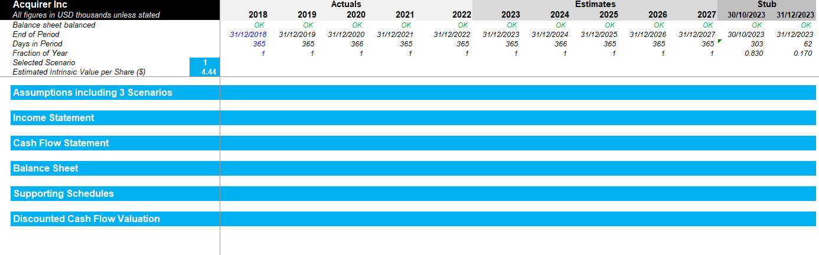
Step 1 - Click on the Acquirer tab and make sure that you do not need to add or remove a building block based on your specificities

Slide 28
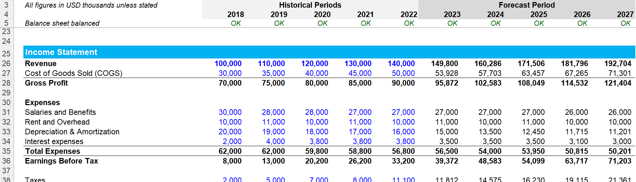
Step 3 - Adjust if required the items in each building block
For example, you may decide to add the item “Dividend payout” by adding a row. Or you may decide to remove the interest expenses. If required, you may have to add a row in the assumption building block if it helps you forecast the future dividend payout

Slide 29
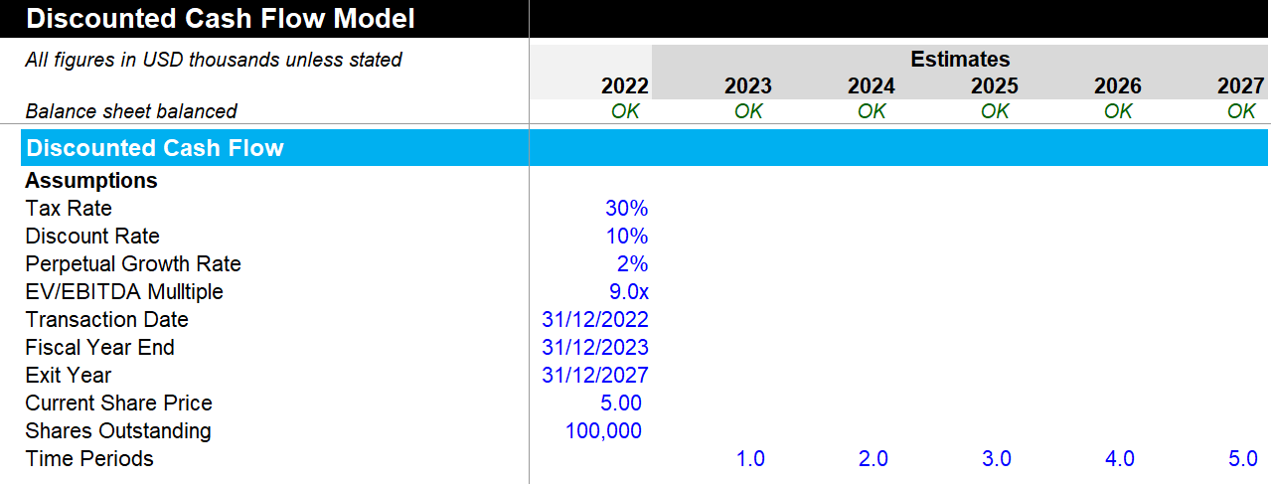
Insert your assumptions in the building block “Discounted Cash Flow”
The discount rate is usually the Weighted Average Cost of Capital (WACC). You can open our WACC Model folder for more details on how to calculate the WACC

Slide 30
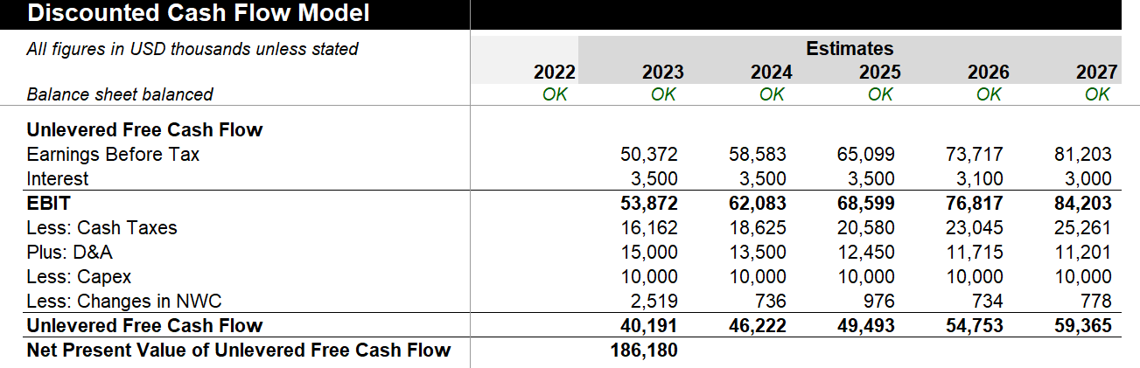
Calculate the Net Present Value of Unlevered Free Cash Flow
Since $1 earned in the future is worth less than $1 earned today, it is important to calculate the Net Present Value of Unlevered Free Cash Flow

Slide 31
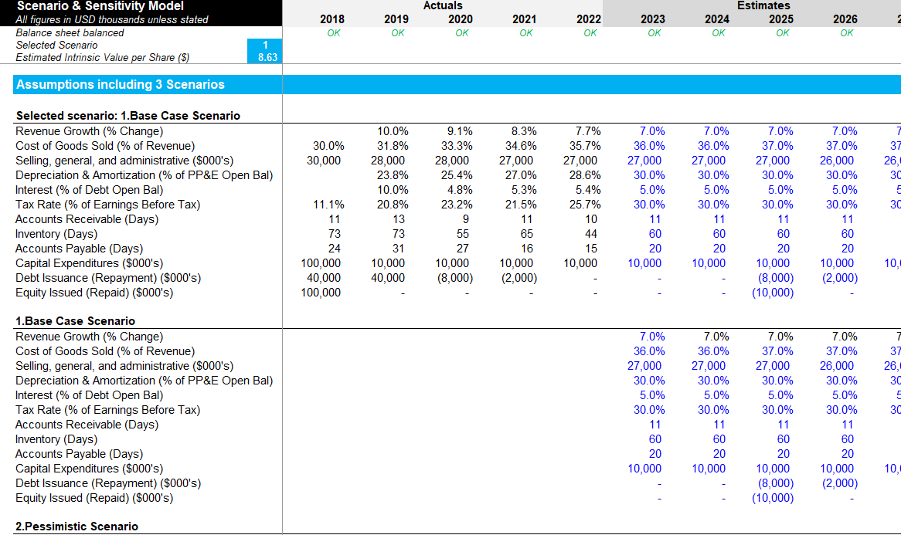
Step 8 - Select the Scenario that will flow in the model
Here we selected the scenario 1.
The estimated intrinsic value per share will update automatically based on selected scenario
As a result, the “Selected scenario” will automatically display the input from the “1.Base Case Scenario”.
If we had selected the scenario 2, the “Selected scenario” would have automatically displayed the input from the “2.Pessimistic Scenario”

Slide 32
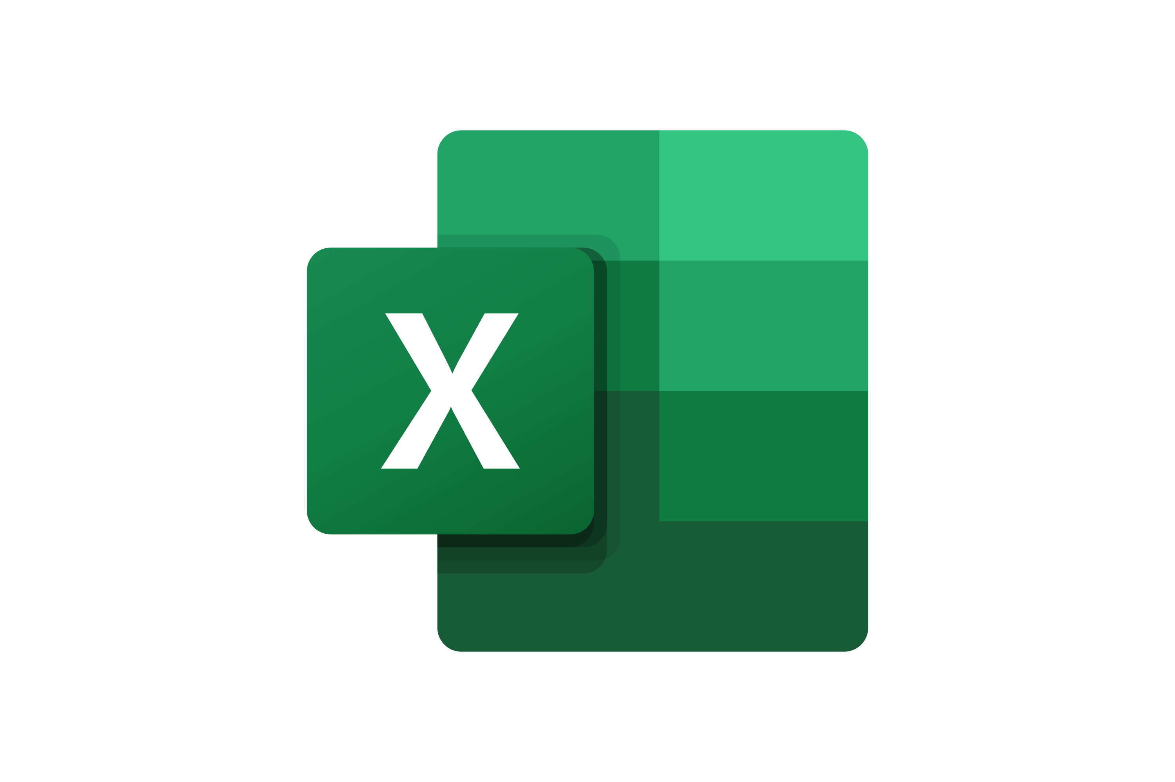
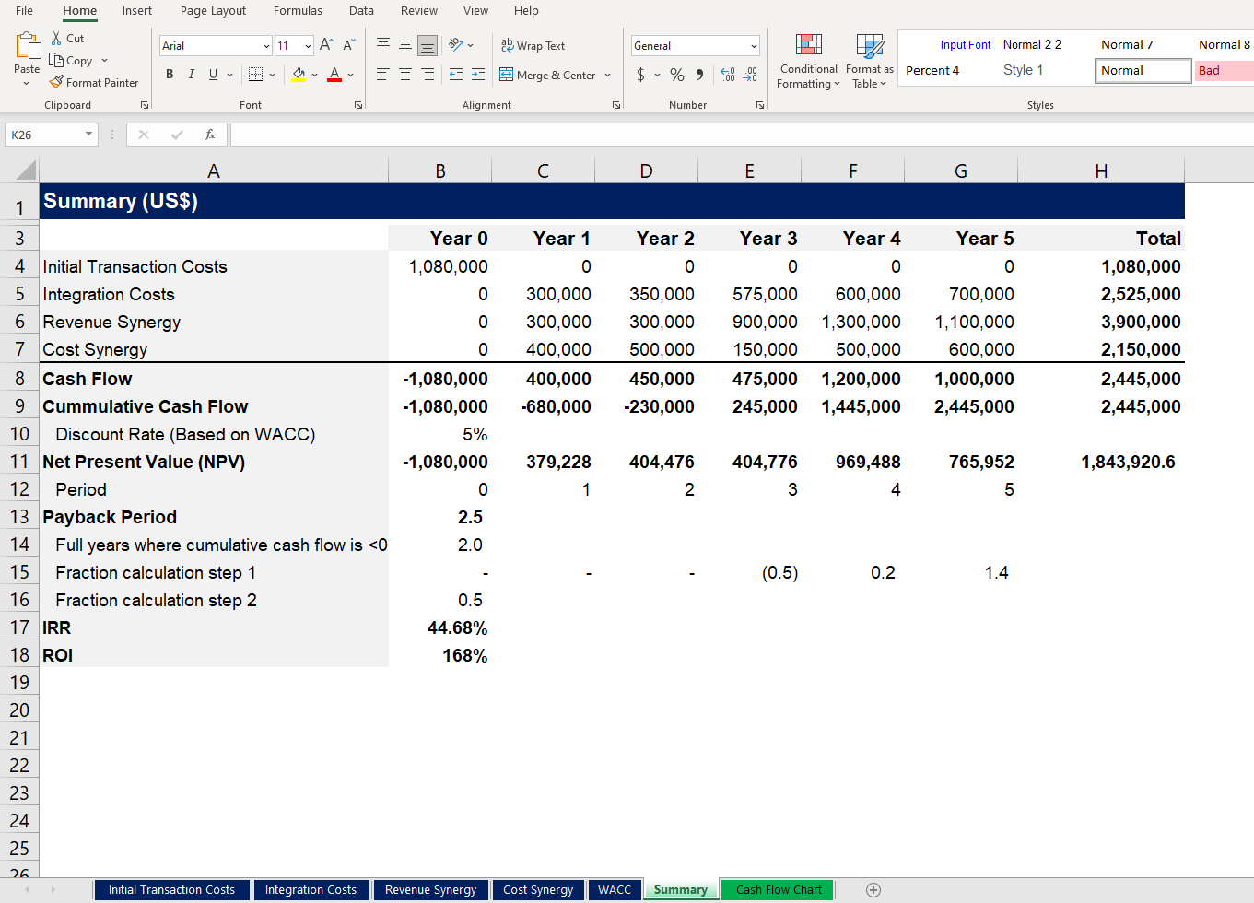
See below a screenshot of the simple version of our M&A financial model.
Screenshots

Slide 33
In the next slides, you’ll see a small preview of Phase IV of our M&A approach
I. Define your M&A Strategy
II. Identify Target Companies
III. Build a Business Case and an M&A Financial Model
IV. Conduct Due Diligence
V. Execute Transaction
VI. Conduct the Post Merger Integration
Company mission, vision and values
M&A strategic objectives and key performance indicators
M&A team
M&A guiding principles
Target screening criteria
Potential target companies and data collection
High-level assessment of potential target companies
Shortlisted potential targets
Financial statements analysis
Valuation: DCF model, comparable company analysis, and precedent transaction analysis
Targets approved for the business case phase
Strategic benefit
Feasibility
Financial benefit
Comprehensive M&A financial model including acquirer model, target model, merger assumptions & analysis, and pro forma model
Simple Financial model including integration cost, revenue synergy, cost synergy, NPV, ROI, and IRR
Letter of intent or term sheet
Work plan including key business case hypotheses & assumptions
Due diligence to validate key hypotheses and assumptions
Updated business valuation
Recommendation to make (or not) a formal offer to acquire the target company
Deal structure
M&A negotiations
Signing and closing the M&A deal
Post merger integration strategy & high-level plan: Strategic objectives, integration management office, guiding principles, high-level plan, organizational structure, top management appointment, synergies, integration & synergy initiatives, business cases and financial models
Post merger integration detailed plans: Detailed integration plan including the day 1 readiness checklist, integration & synergy initiatives plan, etc.
Implementation and monitoring

Slide 34
Once you’ve got your “Hypothesis tree” with your hypothesis, assumptions, sub-assumptions, etc., it’s time to create your work plan
Work plan to validate or invalidate your first hypothesis
For more details, open the Excel sheet “Work Plan”

Slide 35
In the next slides, you’ll see a small preview of Phase V of our M&A approach
I. Define your M&A Strategy
II. Identify Target Companies
III. Build a Business Case and an M&A Financial Model
IV. Conduct Due Diligence
V. Execute Transaction
VI. Conduct the Post Merger Integration
Company mission, vision and values
M&A strategic objectives and key performance indicators
M&A team
M&A guiding principles
Target screening criteria
Potential target companies and data collection
High-level assessment of potential target companies
Shortlisted potential targets
Financial statements analysis
Valuation: DCF model, comparable company analysis, and precedent transaction analysis
Targets approved for the business case phase
Strategic benefit
Feasibility
Financial benefit
Comprehensive M&A financial model including acquirer model, target model, merger assumptions & analysis, and pro forma model
Simple Financial model including integration cost, revenue synergy, cost synergy, NPV, ROI, and IRR
Letter of intent or term sheet
Work plan including key business case hypotheses & assumptions
Due diligence to validate key hypotheses and assumptions
Updated business valuation
Recommendation to make (or not) a formal offer to acquire the target company
Deal structure
M&A negotiations
Signing and closing the M&A deal
Post merger integration strategy & high-level plan: Strategic objectives, integration management office, guiding principles, high-level plan, organizational structure, top management appointment, synergies, integration & synergy initiatives, business cases and financial models
Post merger integration detailed plans: Detailed integration plan including the day 1 readiness checklist, integration & synergy initiatives plan, etc.
Implementation and monitoring

Slide 36
Structuring the deal Overview*
There are many ways in which a corporate merger or acquisition may be structured. The goal is not to create the most complex structure, but rather to create a structure that reflects the objectives of the buyer and the seller fairly.
On a fundamental level, all structures are either mergers or acquisitions, including the purchase or consolidation of either stocks or assets.
At the heart of each transaction are the following key issues that will affect the structure of the deal:
How will tangible and intangible assets be transferred from the seller to the purchaser?
At what price will they be transferred, and according to what terms?
What issues discovered during due diligence may affect the price, terms, or structure of the deal?
What liabilities will be assumed by the purchaser?
What are the tax implications for the buyer and the seller?
What role will the seller have in the management and growth of the underlying business after closing?
To what extent will third-party consent or government filing or approval be necessary?
What arrangement will be made for the key management team of the seller, who may not necessarily be among the selling owners of the company?
Does the buyer currently have access to all of the consideration to be paid to the seller, or will some of these funds need to be raised from debt or equity markets?
And at the heart of each structural alternative are the following 4 basic questions:
Will the buyer be acquiring the stock or the assets of the target?
In what form will the consideration from the buyer to the seller be made (e.g., cash, notes, securities, or some other form)?
Will the purchase price be fixed, contingent, or payable over time on an installment basis?
What are the tax consequences of the proposed structure for the acquisition?
* Source: Book “Mergers & Acquisitions from A to Z” by Andrew J. Sherman, which we highly recommend

Slide 37
Structuring the deal Stock versus asset purchases
Stock purchase advantages and disadvantages
Main advantages
Main disadvantages
Preserves the right of the buyer to use the seller’s name, licenses, and permits.
Provides continuity of corporate identity, contracts, and structure.
There is less flexibility to cherry-pick key assets of the seller.
This structure usually does not terminate existing labor union collective bargaining agreement(s) and generally results in the continuation of employee benefits plans.
Buyer’s perspective
The seller is taxed only on the sales of stock.
Any gain or loss is usually capital in nature.
It does not leave the seller with the problem of disposing of assets that were not bought by the purchaser.
The seller cannot pick and choose the assets to be retained.
A loss on the sale of stock may not be recognized by a corporate shareholder who included the company in its consolidated income tax return.
Seller’s perspective

Slide 38
In the next slides, you’ll see a small preview of Phase VI of our M&A approach
I. Define your M&A Strategy
II. Identify Target Companies
III. Build a Business Case and an M&A Financial Model
IV. Conduct Due Diligence
V. Execute Transaction
VI. Conduct the Post Merger Integration
Company mission, vision and values
M&A strategic objectives and key performance indicators
M&A team
M&A guiding principles
Target screening criteria
Potential target companies and data collection
High-level assessment of potential target companies
Shortlisted potential targets
Financial statements analysis
Valuation: DCF model, comparable company analysis, and precedent transaction analysis
Targets approved for the business case phase
Strategic benefit
Feasibility
Financial benefit
Comprehensive M&A financial model including acquirer model, target model, merger assumptions & analysis, and pro forma model
Simple Financial model including integration cost, revenue synergy, cost synergy, NPV, ROI, and IRR
Letter of intent or term sheet
Work plan including key business case hypotheses & assumptions
Due diligence to validate key hypotheses and assumptions
Updated business valuation
Recommendation to make (or not) a formal offer to acquire the target company
Deal structure
M&A negotiations
Signing and closing the M&A deal
Post merger integration strategy & high-level plan: Strategic objectives, integration management office, guiding principles, high-level plan, organizational structure, top management appointment, synergies, integration & synergy initiatives, business cases and financial models
Post merger integration detailed plans: Detailed integration plan including the day 1 readiness checklist, integration & synergy initiatives plan, etc.
Implementation and monitoring

Slide 39



3-phase approach The Post Merger Integration Toolkit includes a 3-phase approach that we have built and refined over the past 20 years through constant trial and error. The good news is that you don’t have to waste your time, energy, and money going through that lengthy trial-and-error process. You can simply leverage our work and customize it based on the specificities of your organization.
Phase I: Define & Communicate the Strategy & High-Level Plan
Phase II: Develop & Communicate the Detailed Plans
Phase III: Implement & Monitor
Merger strategic objectives
Integration management office
Guiding principles
Post merger integration high-level plan
Organizational structure (Top layers)
Top management appointment
Training to help managers set up their team
Integrated synergy baseline
Synergy targets
Potential integration & synergy initiatives
Business cases and financial models
Integration & synergy initiatives prioritization
Detailed integration plan including the Day 1 readiness checklist
Integration & synergy initiatives plan
Change management strategy and plan
Communication strategy and plan
Culture integration strategy and plan
Risk management strategy and plan
Staffing & retention plan
Status of the post-merger integration high-level plan
Status of the detailed integration plan
Status of the integration and synergy initiatives plan
Status of the change management strategy and plan
Status of the communication strategy and plan
Status of the culture integration strategy and plan
Status of the risk management strategy and plan
Status of staffing and the retention plan
Integration lessons learned
Institutionalization of the updated PMI Toolkit

Slide 40
In the next slides, you’ll see a small preview of Phase I
Phase I: Define & Communicate the Strategy & High-Level Plan
Phase II: Develop & Communicate the Detailed Plans
Phase III: Implement & Monitor
Merger strategic objectives
Integration management office
Guiding principles
Post merger integration high-level plan
Organizational structure (Top layers)
Top management appointment
Training to help managers set up their team
Integrated synergy baseline
Synergy targets
Potential integration & synergy initiatives
Business cases and financial models
Integration & synergy initiatives prioritization
Detailed integration plan including the Day 1 readiness checklist
Integration & synergy initiatives plan
Change management strategy and plan
Communication strategy and plan
Culture integration strategy and plan
Risk management strategy and plan
Staffing & retention plan
Status of the post-merger integration high-level plan
Status of the detailed integration plan
Status of the integration and synergy initiatives plan
Status of the change management strategy and plan
Status of the communication strategy and plan
Status of the culture integration strategy and plan
Status of the risk management strategy and plan
Status of staffing and the retention plan
Integration lessons learned
Institutionalization of the updated PMI Toolkit

Slide 41

The strategic objectives of our merger are:
Template
Don’t reinvent the wheel here. Most of the strategic objectives should have already been written prior to the deal.
1
Replace this text with your own text
2
Replace this text with your own text
3
Replace this text with your own text
4
Replace this text with your own text
5
Replace this text with your own text
6
Replace this text with your own text

Slide 42
The most common strategic objectives of mergers are:
Example
Example we used during a PMI consulting project we did for a Global Fortune 1000 firm.
1
Gaining economies of scale
2
Entering a new country
3
Entering a new market
4
Increasing the company’s product or service portfolio
5
Increasing market share by acquiring one of your competitors (horizontal integration)
6
Becoming a key player in an industry by acquiring one of your suppliers or clients (vertical integration)

Slide 43
We decided to create an Integration Management Office that will be responsible for the success of the integration
The Integration Management Office will oversee the post Merger Integration and be responsible for its success. It includes 7 [replace this number with your own number] executives representing both [insert name of the acquiring company] and [insert name of the acquired company]:
This is only an example. You may decide to emphasize different areas and adjust the size of the integration Management Office.
Integration Management Officer
[Insert name]
Integration and Synergy Initiatives
[Insert name]
Change Management
[Insert name]
Communication
[Insert name]
Culture
[Insert name]
Risk Management
[Insert name]
Training
[Insert name]

Slide 44
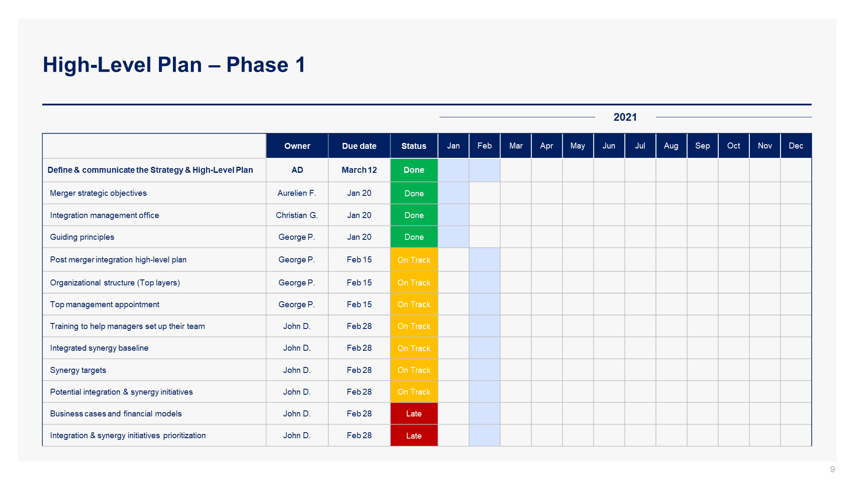
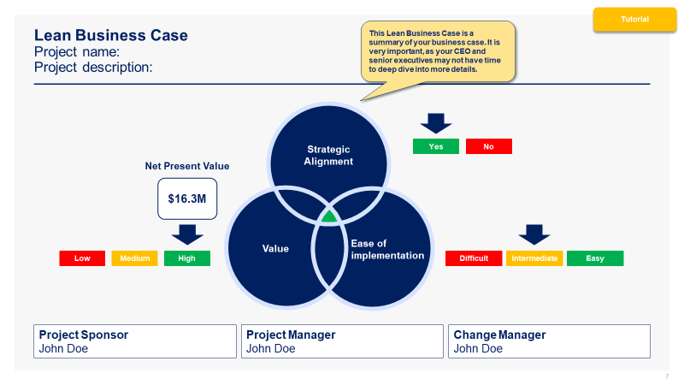
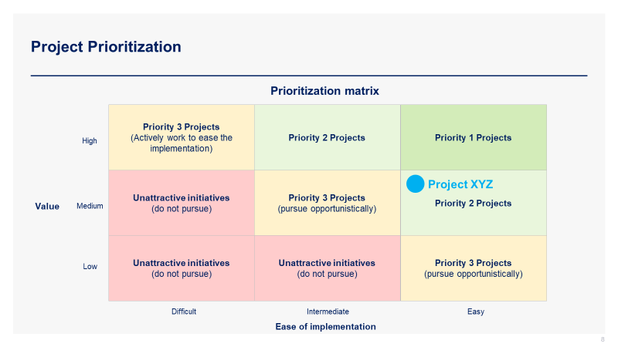
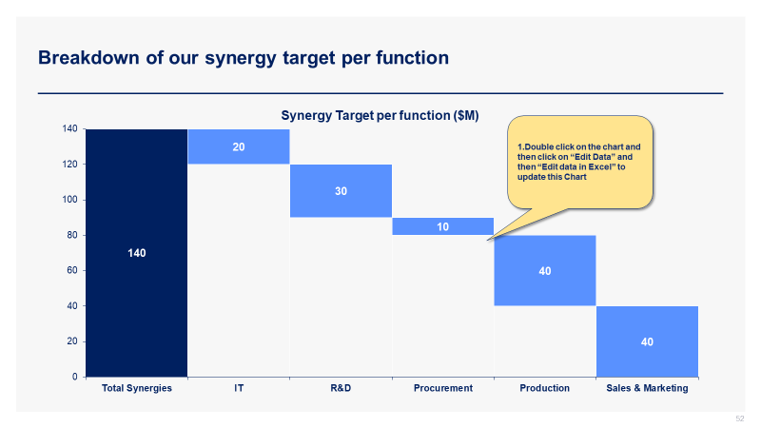
See below 4 screenshots from Phase I.
Screenshots
High-Level Plan
Lean Business Case
Prioritization Matrix
Synergy Target Breakdown

Slide 45
In the next slides, you’ll see a small preview of Phase II.
Phase I: Define & Communicate the Strategy & High-Level Plan
Phase II: Develop & Communicate the Detailed Plans
Phase III: Implement & Monitor
Merger strategic objectives
Integration management office
Guiding principles
Post merger integration high-level plan
Organizational structure (Top layers)
Top management appointment
Training to help managers set up their team
Integrated synergy baseline
Synergy targets
Potential integration & synergy initiatives
Business cases and financial models
Integration & synergy initiatives prioritization
Detailed integration plan including the Day 1 readiness checklist
Integration & synergy initiatives plan
Change management strategy and plan
Communication strategy and plan
Culture integration strategy and plan
Risk management strategy and plan
Staffing & retention plan
Status of the post-merger integration high-level plan
Status of the detailed integration plan
Status of the integration and synergy initiatives plan
Status of the change management strategy and plan
Status of the communication strategy and plan
Status of the culture integration strategy and plan
Status of the risk management strategy and plan
Status of staffing and the retention plan
Integration lessons learned
Institutionalization of the updated PMI Toolkit

Slide 46
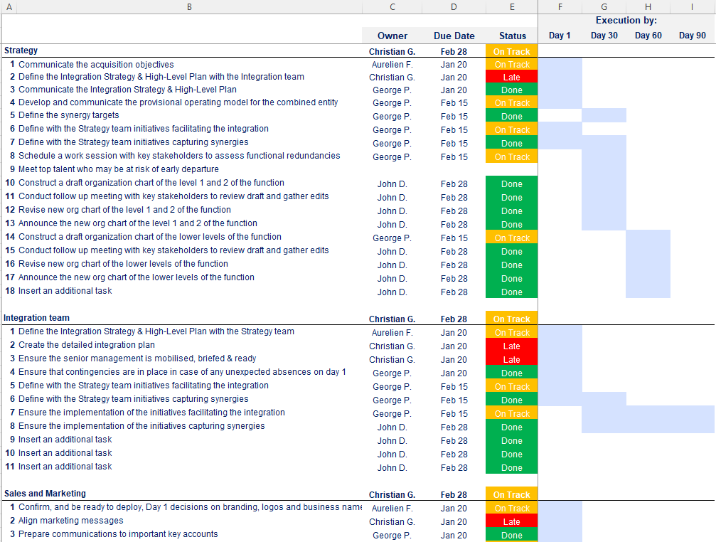
Detailed integration plan including the Day 1 readiness checklist
Open the Excel document “Detailed Integration Plan” to see the 300+ activities listed in the plan

Slide 47
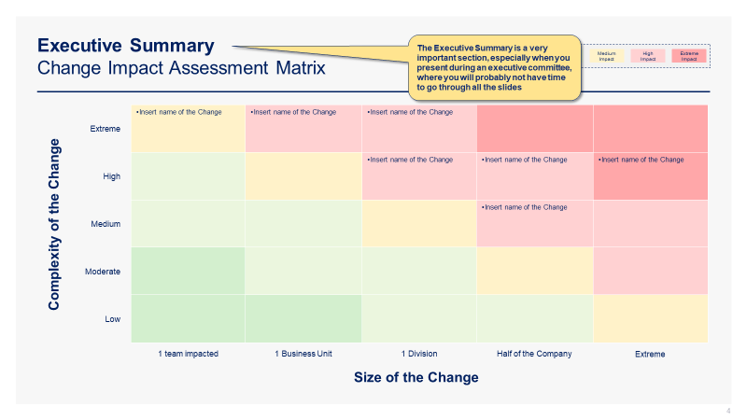
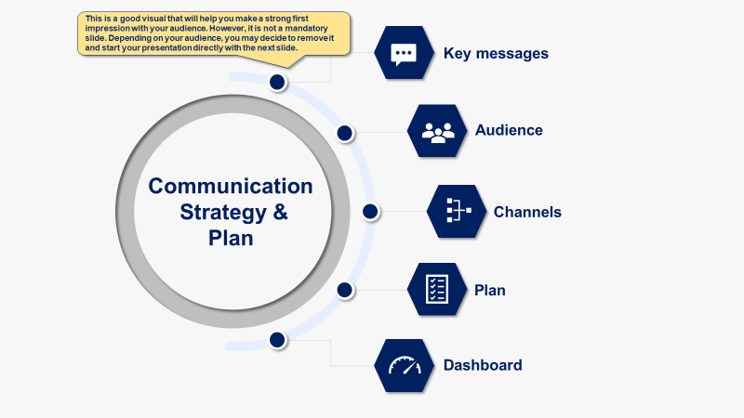
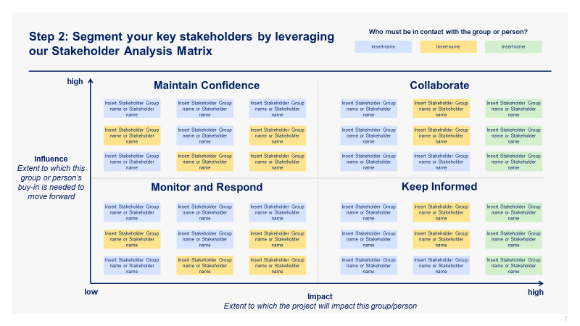
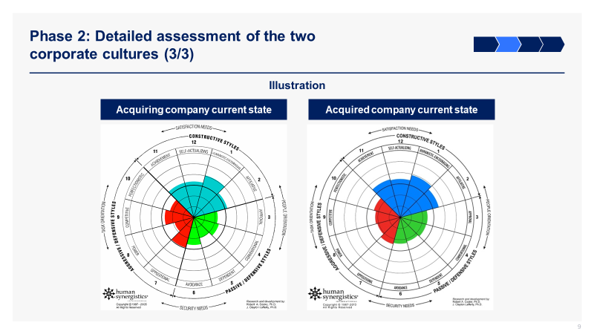
See below 4 additional screenshots from Phase II.
Screenshots
Change Impact Assessment Matrix
Communication Strategy & Plan
Stakeholder Analysis Matrix
Culture Integration Strategy

Slide 48
In the next slides, you’ll see a small preview of Phase III.
Phase I: Define & Communicate the Strategy & High-Level Plan
Phase II: Develop & Communicate the Detailed Plans
Phase III: Implement & Monitor
Merger strategic objectives
Integration management office
Guiding principles
Post merger integration high-level plan
Organizational structure (Top layers)
Top management appointment
Training to help managers set up their team
Integrated synergy baseline
Synergy targets
Potential integration & synergy initiatives
Business cases and financial models
Integration & synergy initiatives prioritization
Detailed integration plan including the Day 1 readiness checklist
Integration & synergy initiatives plan
Change management strategy and plan
Communication strategy and plan
Culture integration strategy and plan
Risk management strategy and plan
Staffing & retention plan
Status of the post-merger integration high-level plan
Status of the detailed integration plan
Status of the integration and synergy initiatives plan
Status of the change management strategy and plan
Status of the communication strategy and plan
Status of the culture integration strategy and plan
Status of the risk management strategy and plan
Status of staffing and the retention plan
Integration lessons learned
Institutionalization of the updated PMI Toolkit

Slide 49
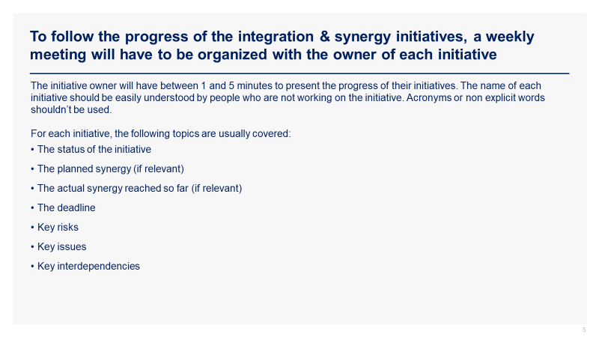
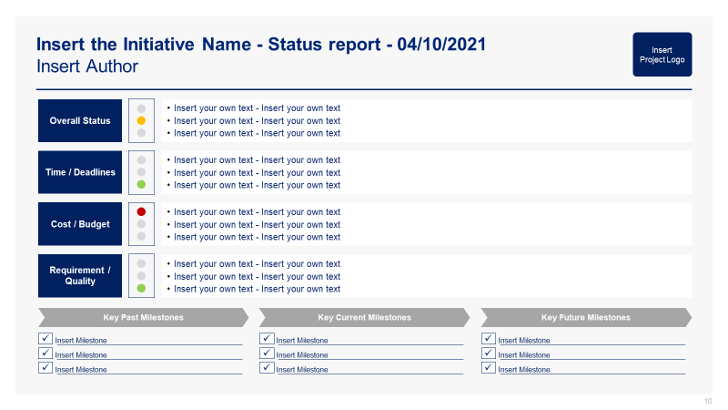
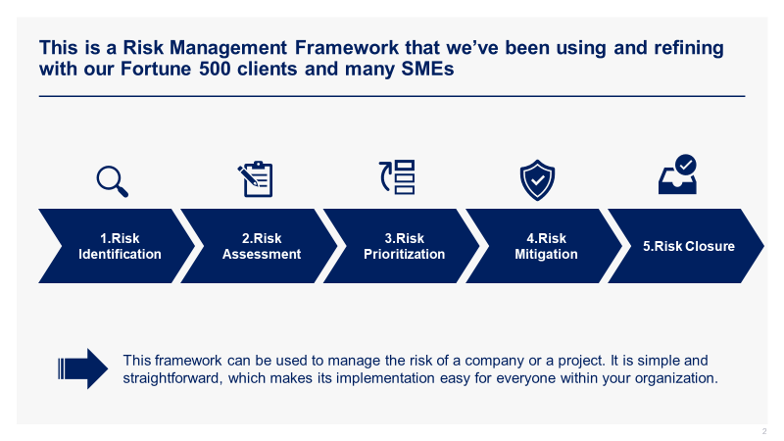
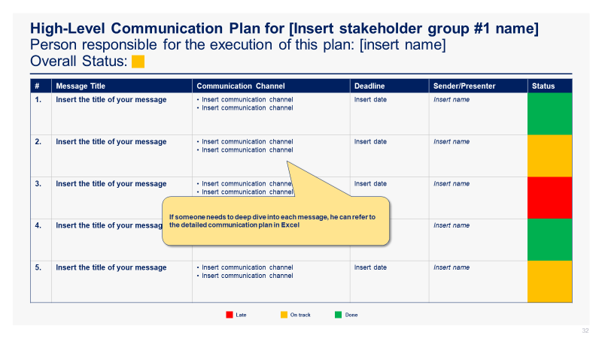
See below 4 additional screenshots from Phase III.
Screenshots
Governance
Initiative Status Report
Risk Management Framework
Communication Plan

Slide 50





Structure of the Toolkit The M&A Toolkit includes 600 Powerpoint slides, 65 Excel sheets, 7 Word pages and 37 minutes of Video training organized in 7 folders that you can download on your device immediately after your purchase.
+
+
+
600 editable Powerpoint slides*
65 editable Excel sheets*
7 editable Word pages
37 minutes of Video training
0. Overview and Approach
I. M&A Strategy
II. Target companies
III. Business Case and Financial Model
IV. Due Diligence
V. Transaction Execution
VI. Post Merger Integration
*Please note that the number of PowerPoint slides and Excel sheets listed is the number of unique slides and sheets. For example, a PowerPoint slide that has been duplicated to facilitate our clients’ understanding only counts for 1 slide.

Slide 51









Key Benefits of our Management Consulting Toolkits
Improve the growth & efficiency of your organization by leveraging Management Consulting Toolkits created by ex-McKinsey, Deloitte & BCG Consultants.
Make a great investment for your career & organization. It cost us US$8M+ over the past 10 years to create all our Toolkits. Get them for a fraction of this cost.
Get a competitive advantage. It’s like hiring Management Consultants to create all the practical Frameworks, Tools & Templates you need.
Get the job done quicker and never start from scratch again with our ready-made and fully editable Frameworks, Tools & Templates in Powerpoint & Excel.
Don't reinvent the wheel. We have already worked 30,000+ hours over the past 10 years to create all the Management Consulting Toolkits you need.
Improve the capabilities of your organization by learning how the Fortune 100 and Global Consulting Firms do it.
Decrease your costs. Hiring tier-1 Consultants for a project would cost you $300k+. Way more expensive than our Toolkits, which will last you a lifetime!
Become your organization’s subject matter expert and impress your stakeholders with world-class approaches to resolve common business problems.
Get free support and advice from our ex-McKinsey, Deloitte & BCG Management Consultants.

Slide 52
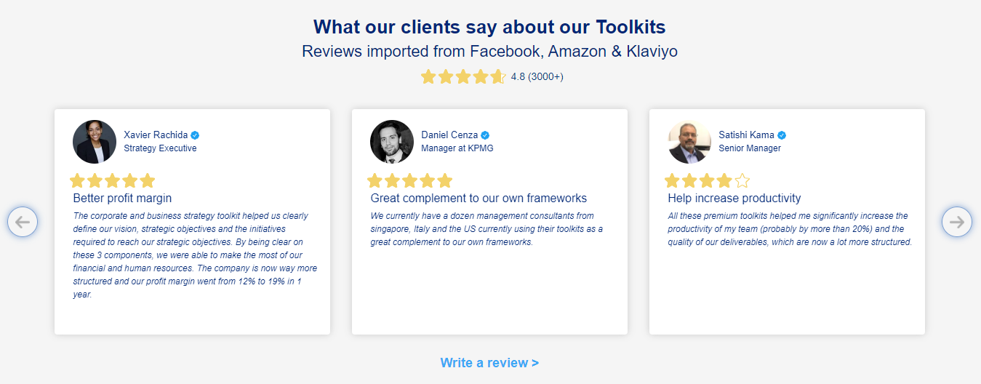
What our clients say about our Toolkits Reviews imported from Facebooks, Amazon and Klaviyo
See more reviews >

Slide 53

Join the 200,000+ Executives, Consultants & Entrepreneurs already leveraging our Business & Consulting Toolkits to improve the performance of their organization and boost their own career.
Trusted by small and large organizations
Customer satisfaction
4.8
Number of countries leveraging our Business & Consulting Toolkits
160+
Number of professionals leveraging our Business & Consulting Toolkits
200,000+
Daily rate of our ex-McKinsey, Deloitte and BCG Management Consultants
$3k-$4k

Slide 54

Interested in more than 1 Toolkit? Access all our Toolkits for half the price with our Gold Access
Gold Access
Click here to learn more

Slide 55

Thank you for your attention.
www.domontconsulting.com

